Slide 1

CN101.3 - Data Communication and Network
Department of Network and Security
TCP and UDP Basics
Isuru Sri Bandara
isuru.s@nsbm.ac.lk

Slide 2

What is TCP and UDP ?

Slide 3
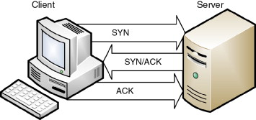
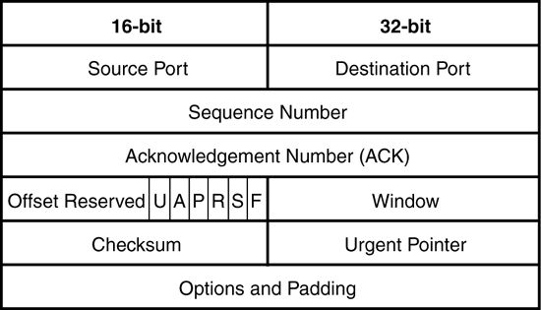
Transmission Control Protocol - TCP
Connection oriented
Reliable delivery
Can manage out of order massagers
Check for damaged or missing data
Retransmissions available

Slide 4
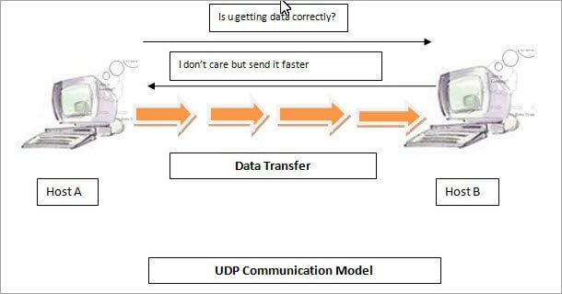
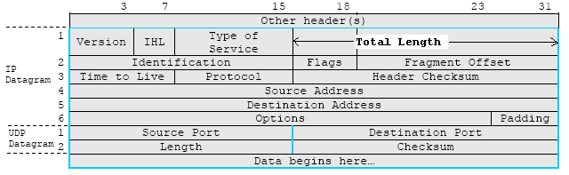
User Datagram Protocol - UDP
Connectionless
Unreliable delivery
Can’t Check for damaged or missing data
Retransmissions is not available

Slide 5
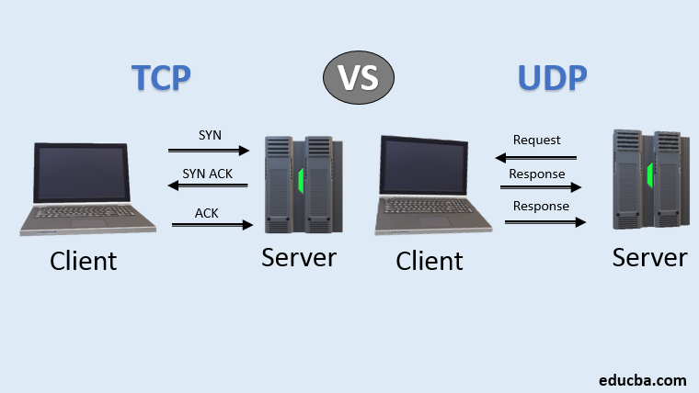
TCP vs UDP

Slide 6
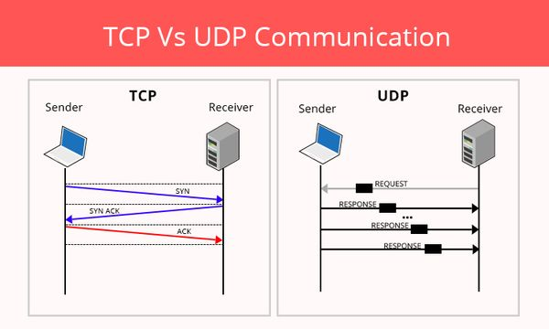
TCP vs UDP

Slide 7
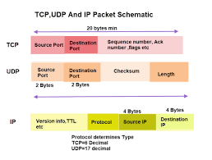
TCP vs UDP

Slide 8
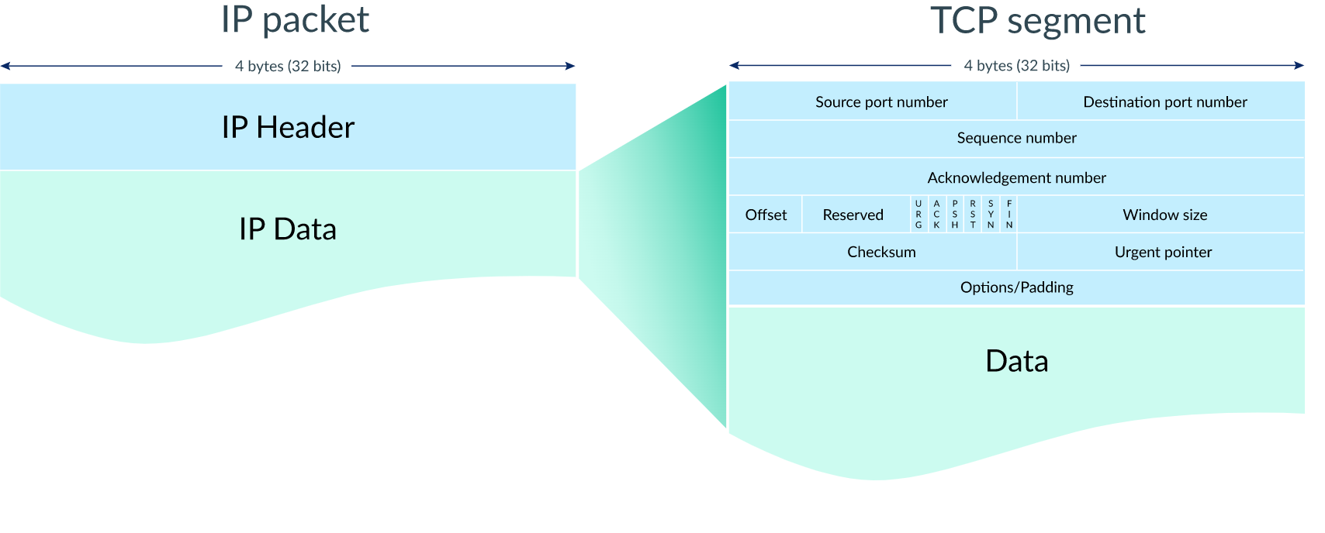
TCP/IP Communication Structure

Slide 9
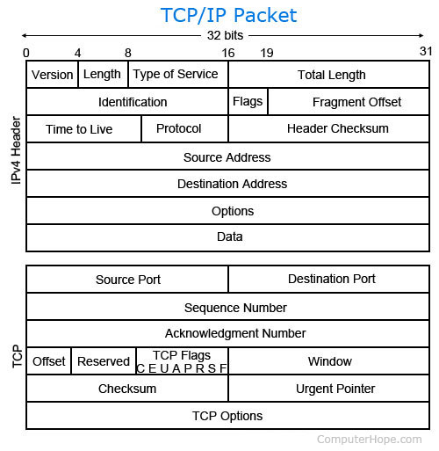
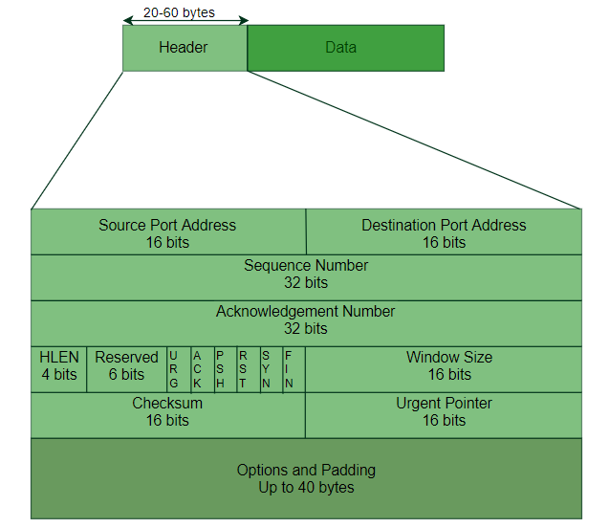
TCP/IP Communication Structure

Slide 10
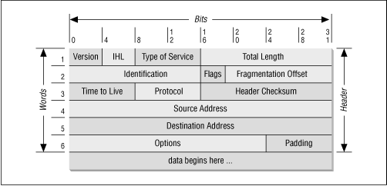
TCP/IP Communication Structure

Slide 11
Key terms
Source Port Address
Destination Port Address
Sequence Number
Acknowledgement Number
Header Length (HLEN)
Control flags
Window size
Checksum
Urgent pointer

Slide 12
Why do we need Ports ?

Slide 13
Key terms
Source Port Address
A 16-bit field that holds the port address of the application that is sending the data segment
Destination Port Address
A 16-bit field that holds the port address of the application in the host that is receiving the data segment.
Port Range : 0 - 65,535 (2^16)
Well-known port : 0 – 1023
Port numbers are for communication not for security
TCP port numbers aren’t the same as UDP port numbers

Slide 14
Key terms
Sequence Number
A device initiating a TCP connection must choose a random initial sequence number, which is then incremented according to the number of transmitted bytes.
Acknowledgement Number
The receiving device maintains an acknowledgment number starting with zero. It increments this number according to the number of bytes received.

Slide 15
Key terms
Header Length (HLEN)
defines the length of the datagram header in 4-byte word.
Control flags
TCP uses nine control flags to manage data flow in specific situations, such as the initiating of a reset.
Window size
The window size indicates the size of the receive buffer. Checksum
Urgent pointer
If URG control flag is set, this value indicates an offset from the sequence number, indicating the last urgent data byte
Notes:
(Sliding window)

Slide 16
Does the TCP use three-way handshake ?

Slide 17
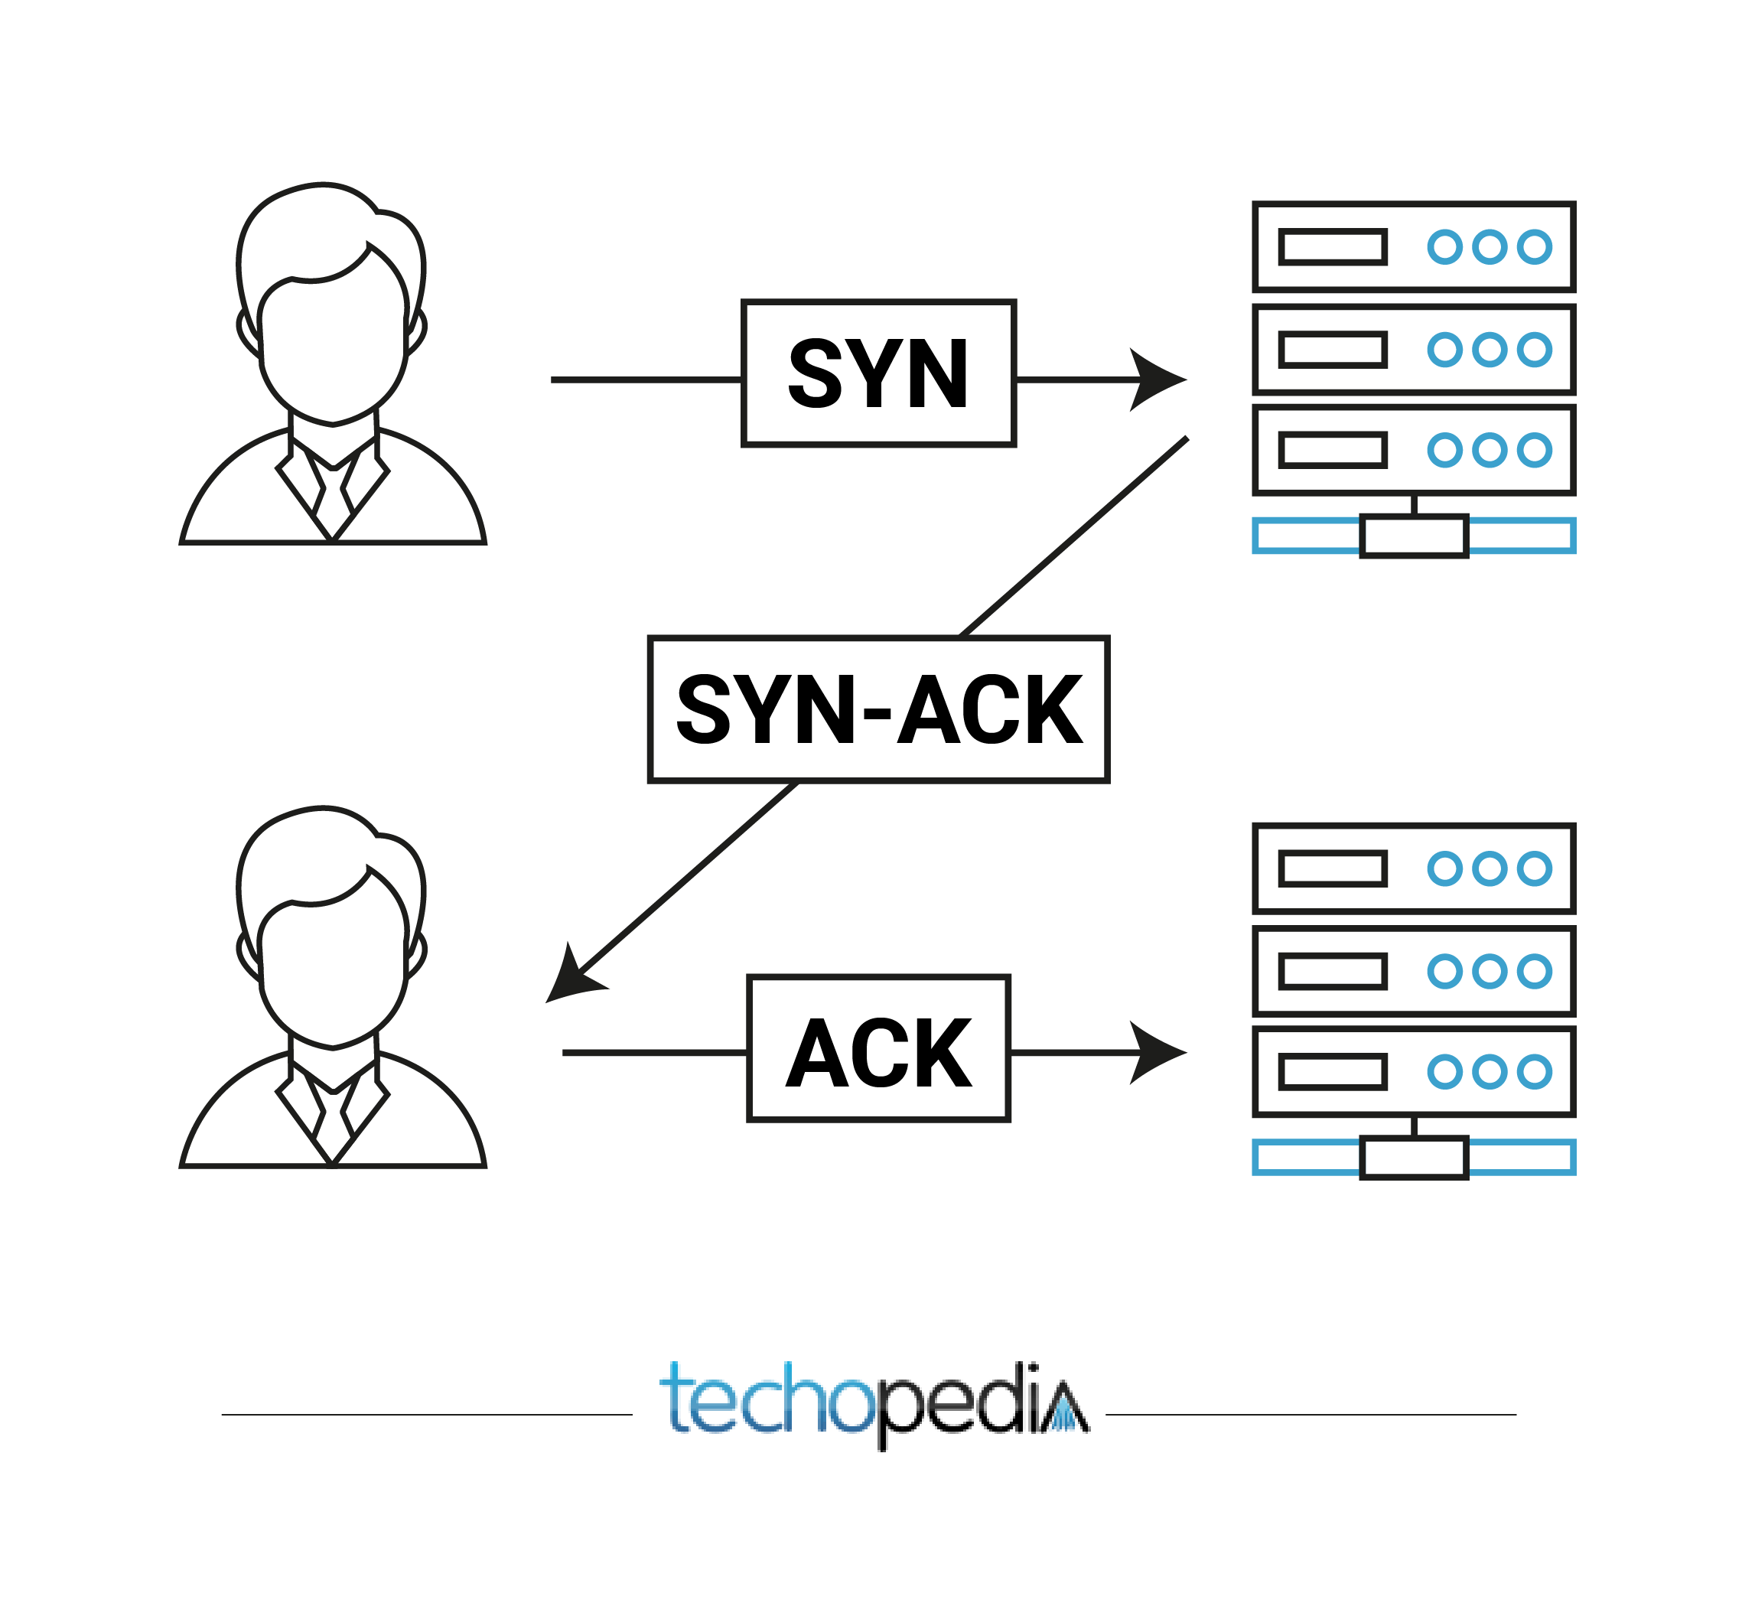
TCP Three-way Handshake
A three-way handshake is also known as a TCP handshake or SYN-SYN-ACK, and requires both the client and server to exchange SYN (synchronization) and ACK (acknowledgment) packets before actual data communication begins.

Slide 18
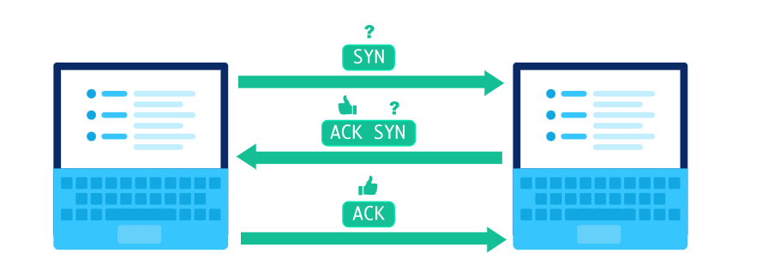
Step 01 - Initiation
When two computers want to send data to each other over TCP, they first need to establish a connection using a three-way handshake.

Slide 19
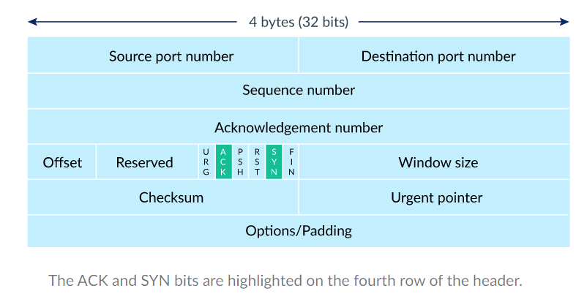
Step 01 - Initiation
The initiator sends a packet with the SYN bit set to 1 (SYN = "synchronize?").
The second computer sends back a packet with the ACK bit set to 111 (ACK = "acknowledge!") plus the SYN bit set to 111.
The first computer replies back with an ACK.
Note: - During the handshake does not include any data of the user

Slide 20
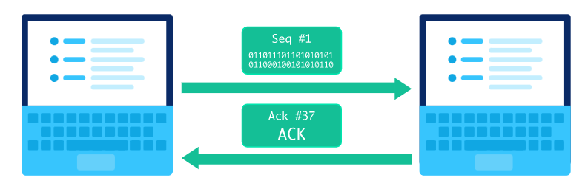
Step 02 – Data Communication
The first computer sends a packet with data and a sequence number.
The second computer acknowledges it by setting the ACK bit and increasing the acknowledgement number by the length of the received data.

Slide 21
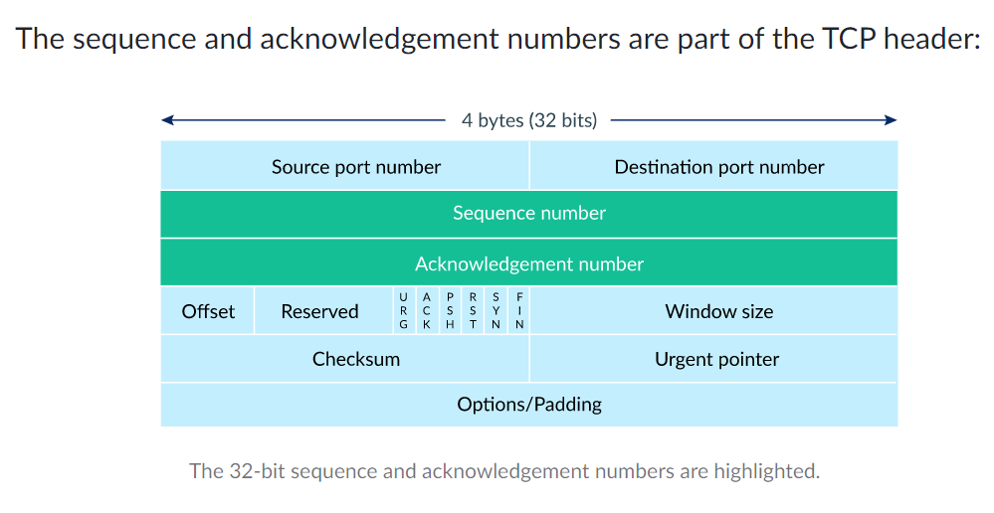
Step 02 – Data Communication

Slide 22
Step 03 – Closing the connection
A computer initiates closing the connection by sending a packet with the FIN bit set to 1 (FIN = finish).
The other computer replies with an ACK and another FIN.
After one more ACK from the initiating computer, the connection is closed.

Slide 23

Thank You

